Slide 1
Seg geometry: key points
28/08/2020
Simone Ferrari (simone.ferrari@polito.it)

Slide 2
Notes
This document contains the key points of the geometry definition for Seg rotors, divided in:
Base geometry
Radial ribs
Split radial ribs
PM

Slide 3
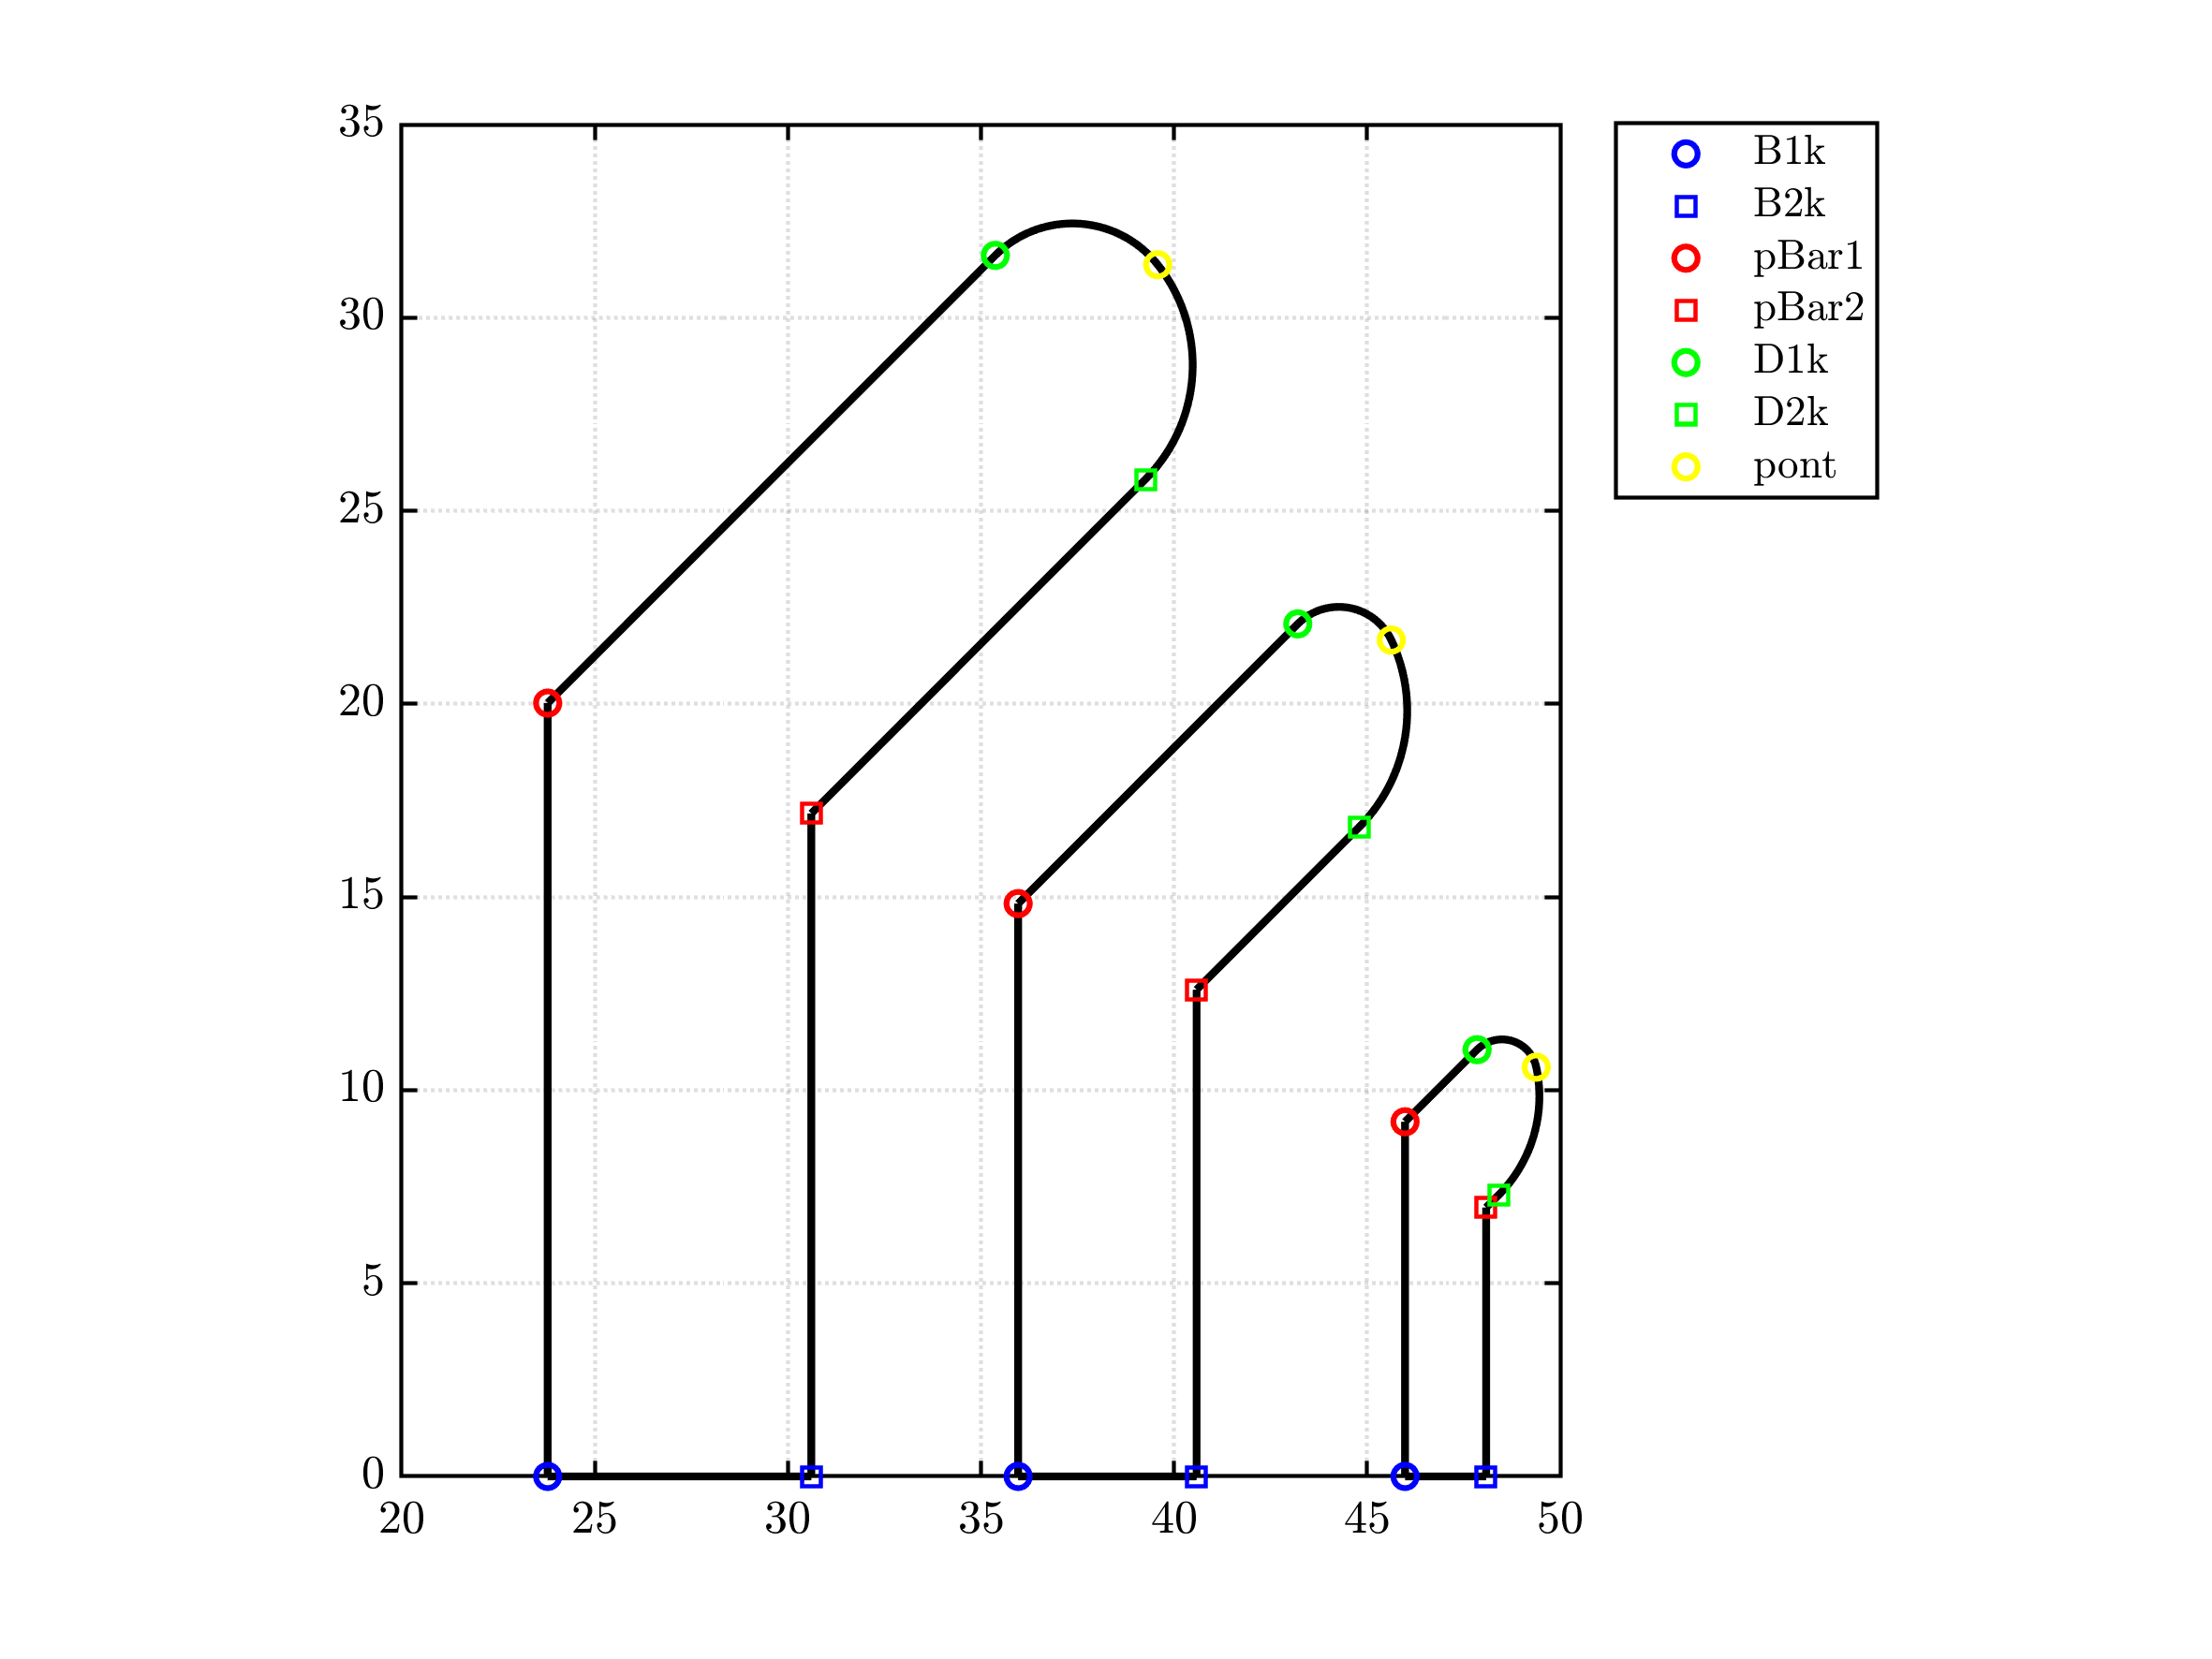
Base geometry

Slide 4
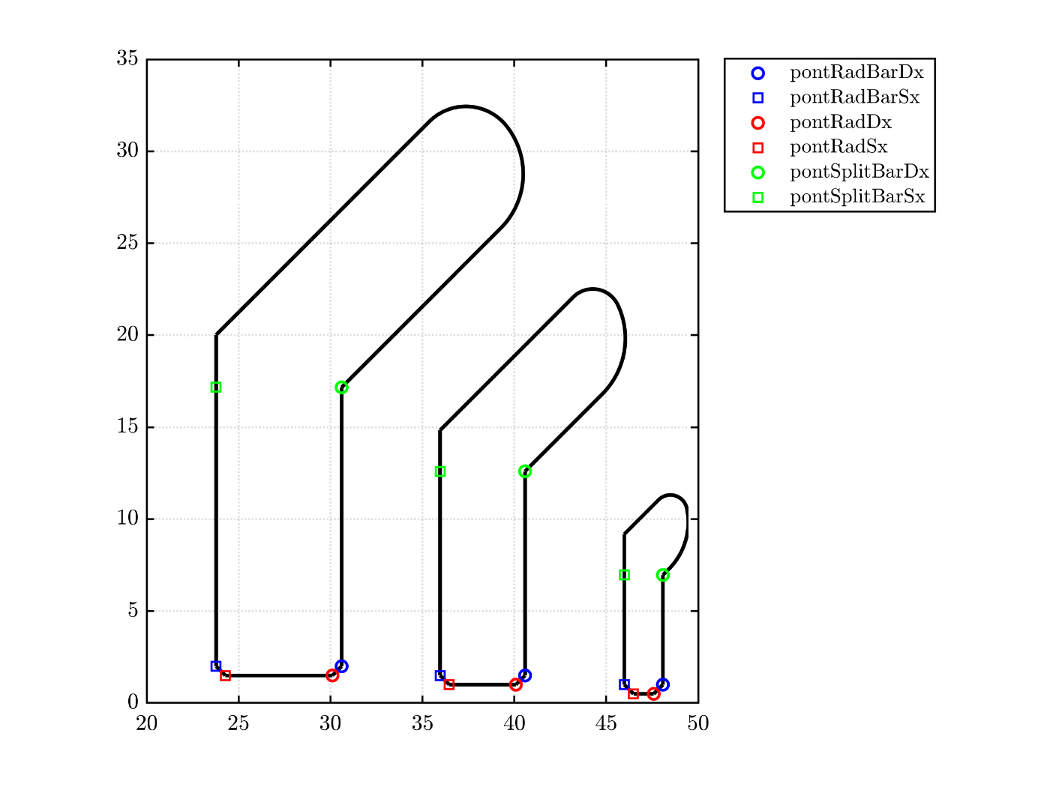
Radial ribs

Slide 5
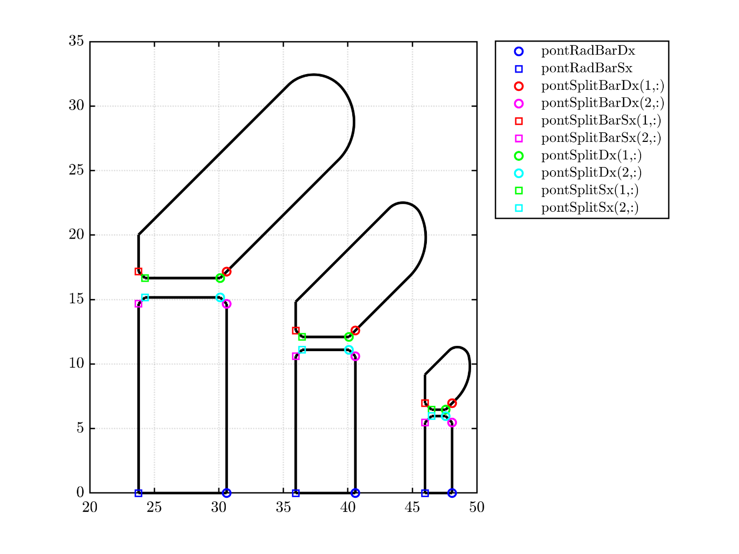
Split radial ribs

Slide 6
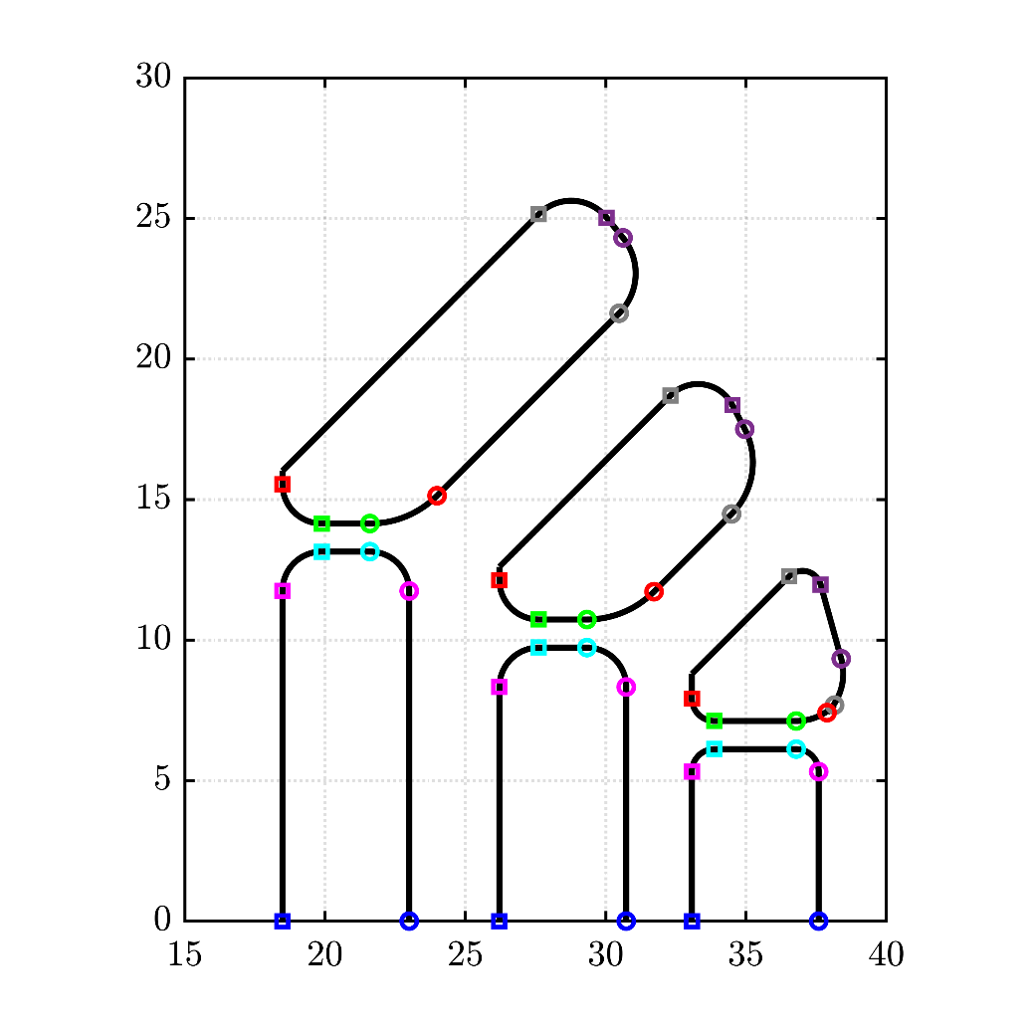
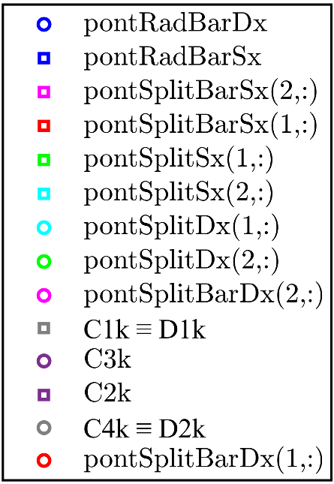
Inclined ribs and Rotor Fillet

Slide 7
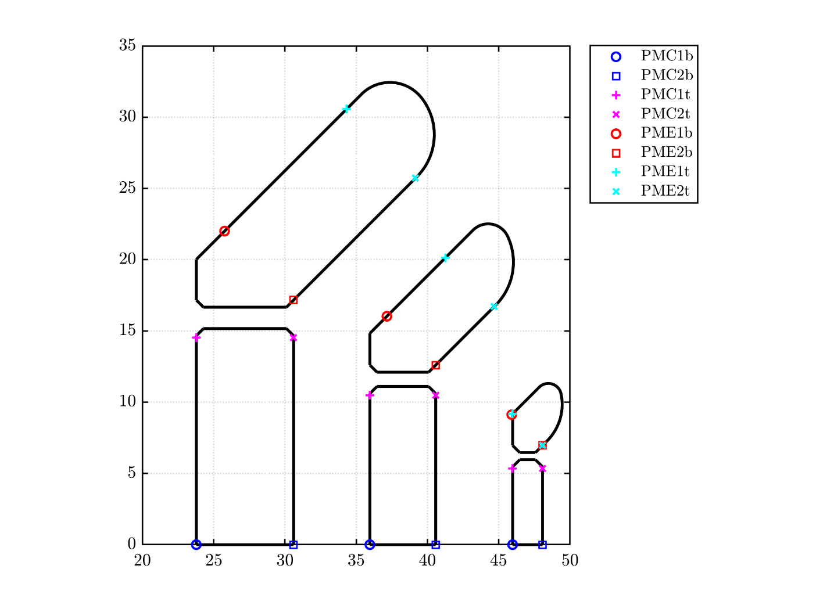
Permanent Magnets

